Slide 1
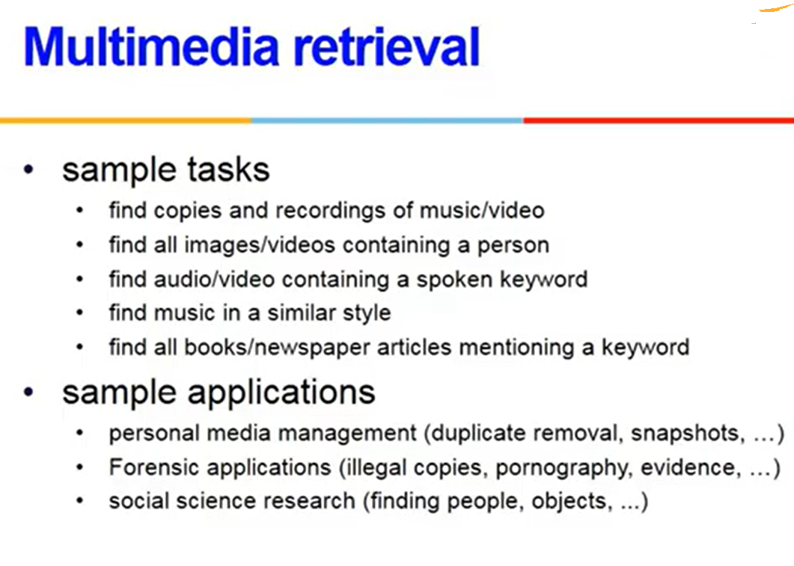

Slide 2
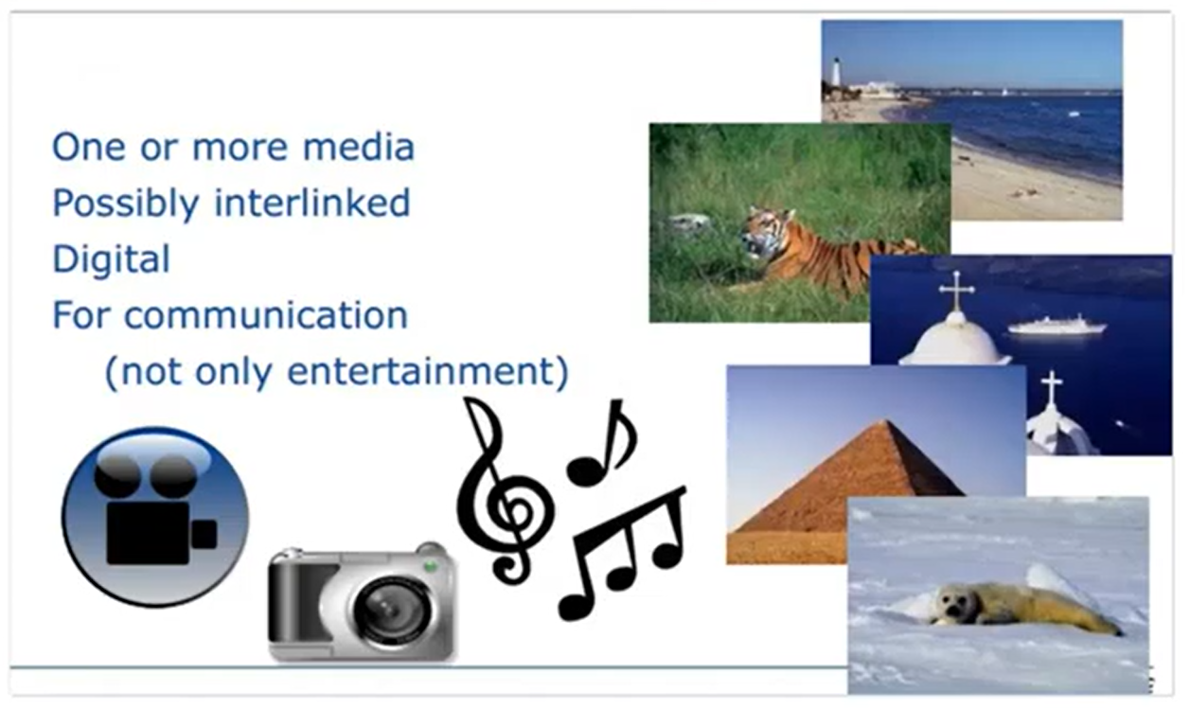
What is Multimedia?

Slide 3
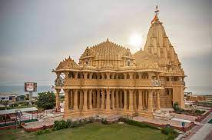
Multimedia Queries

Slide 4
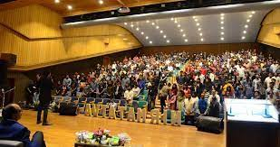
Web based image search Nirma University auditorium

Slide 5
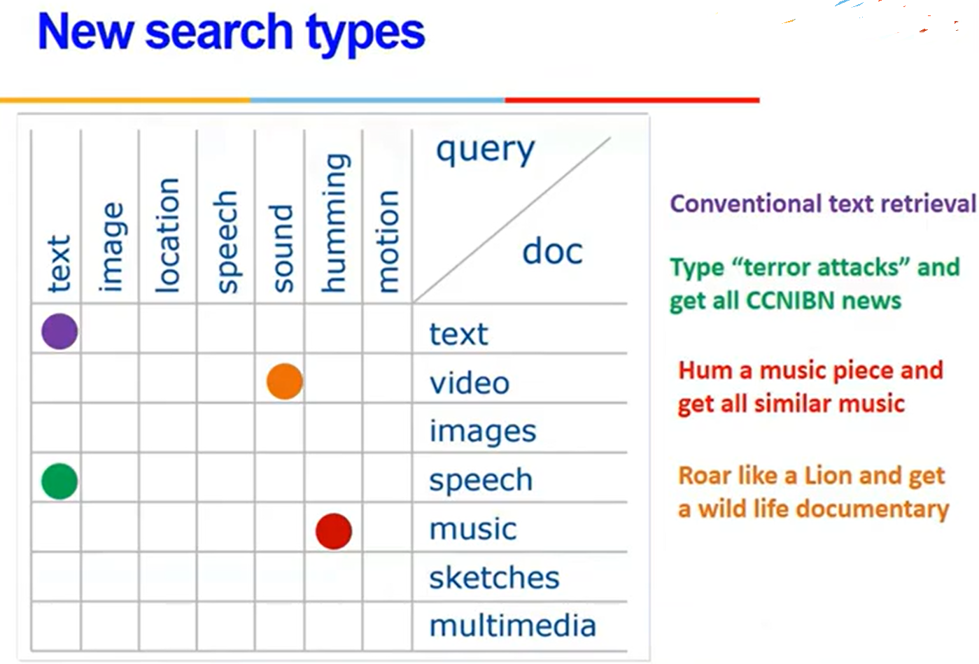

Slide 6
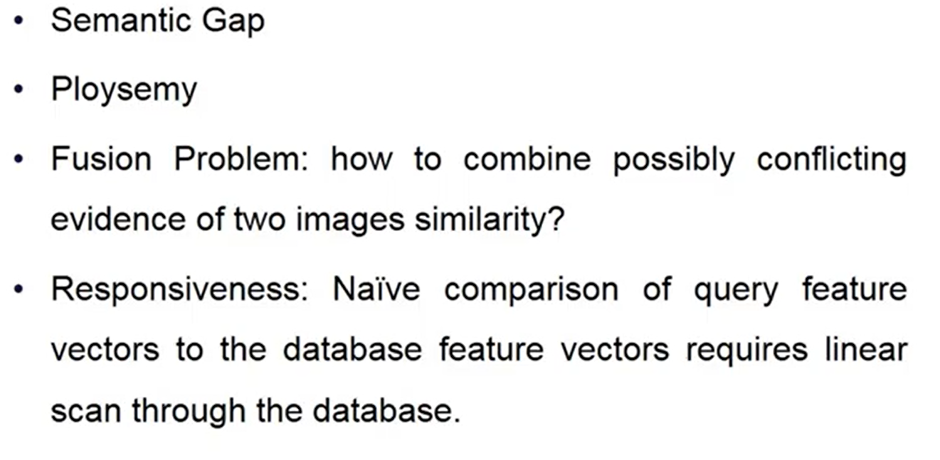
Challenges in MMIR

Slide 7
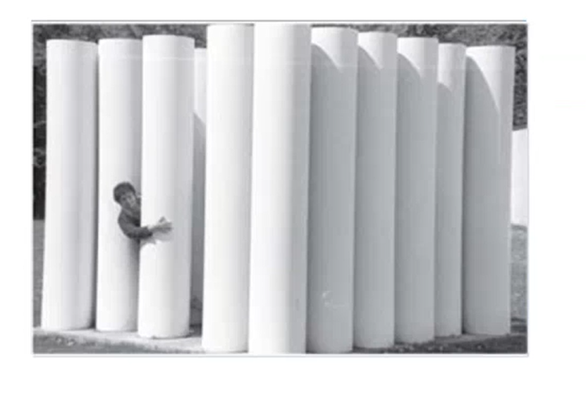
Polysemy

Slide 8
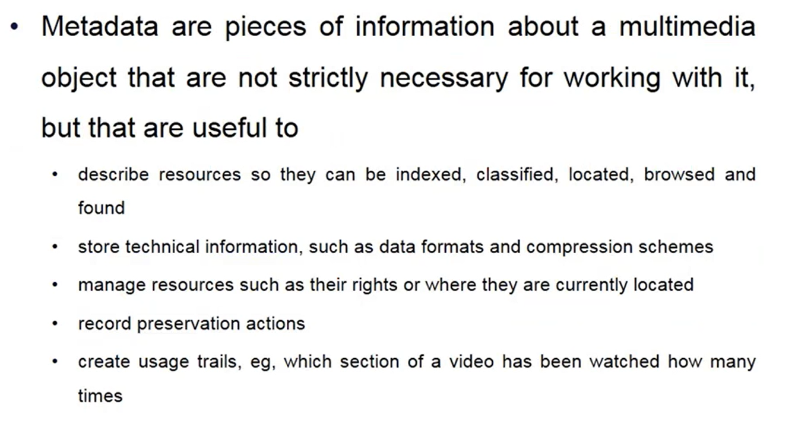

Slide 9
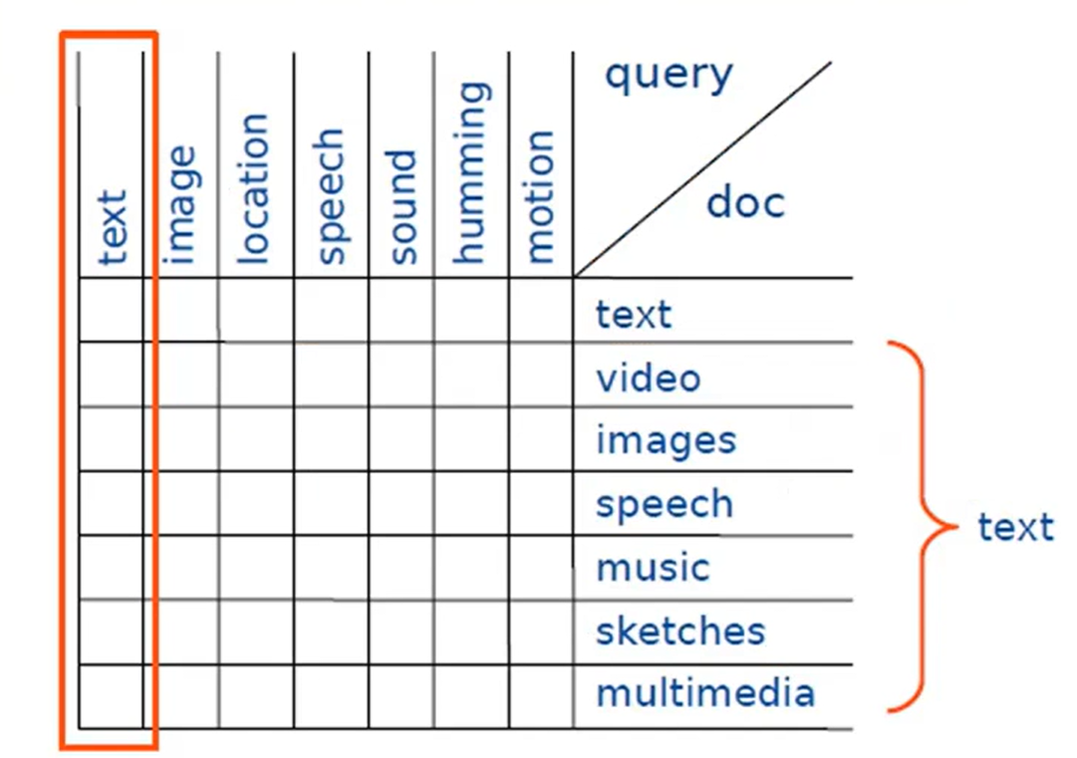
Piggyback retrieval

Slide 10
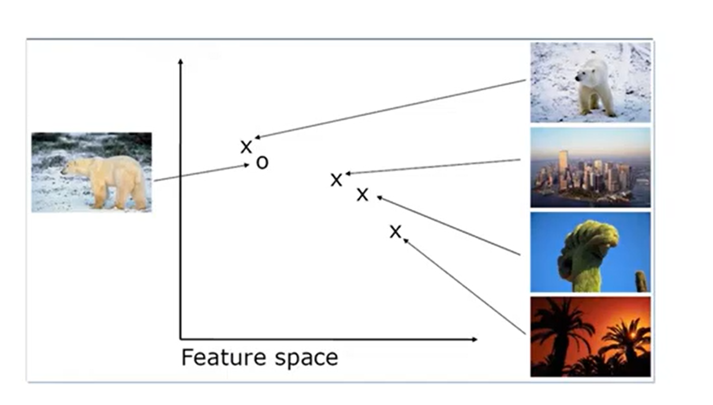
Content based image retrieval

Slide 11
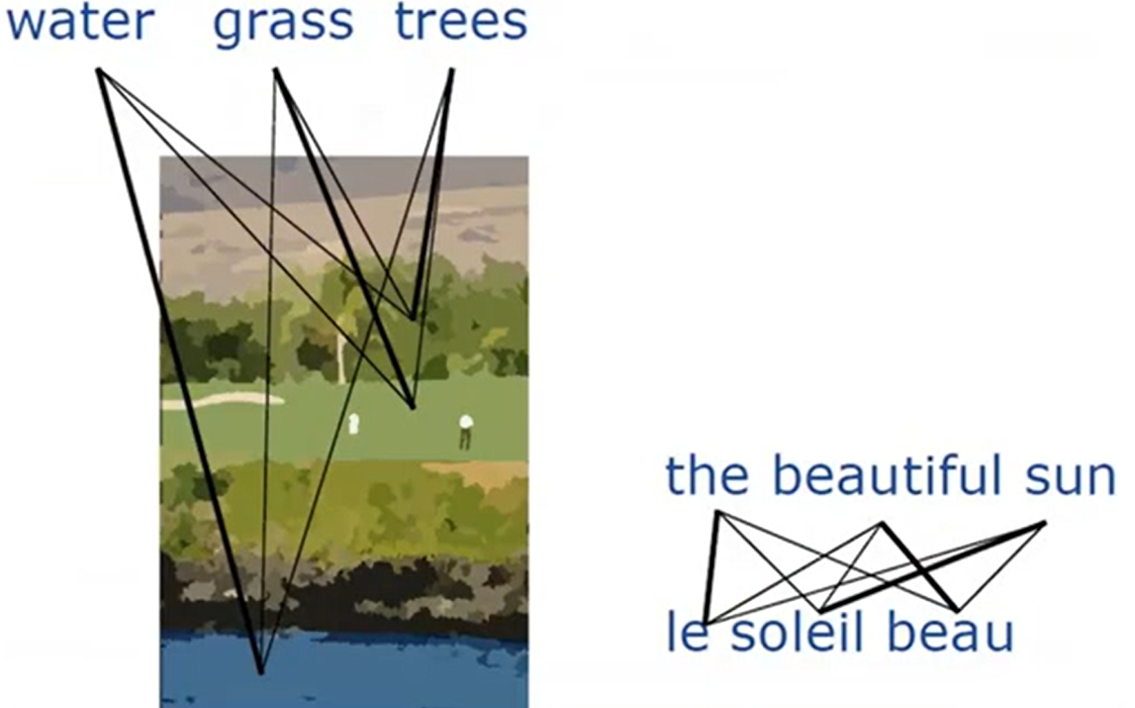
Image Annotation

Slide 12
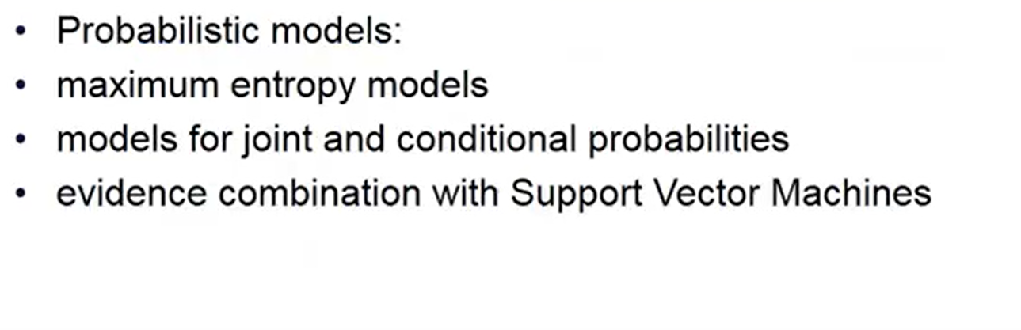
Automatic Annotation (ML)

Slide 13
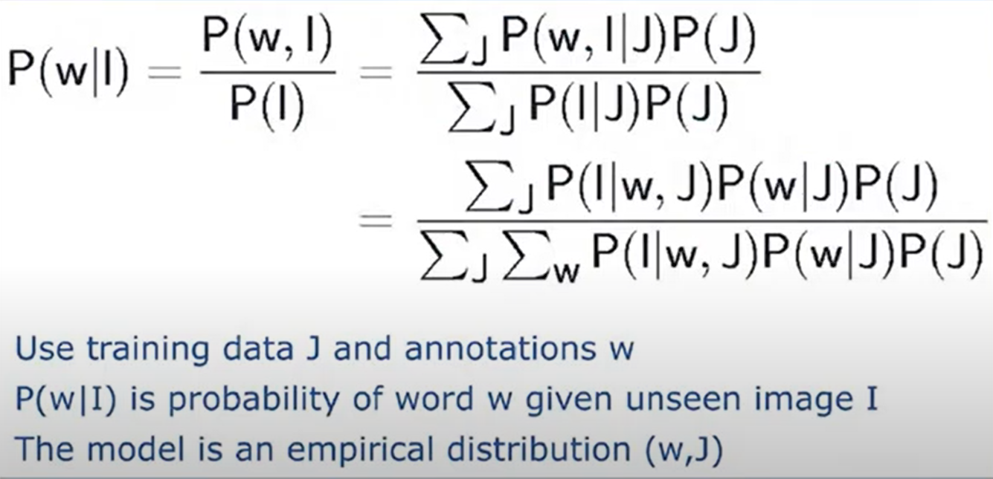
A simple bayesian classifier

Slide 14
Keyword is associated with the visual term
Calculate the probabilities of translation of this visual term into water, into the grass and into the tree and whichever probability is highest that is the correct annotation of this visual term.
Training data is required. The initial set of annotations is required.

Slide 15
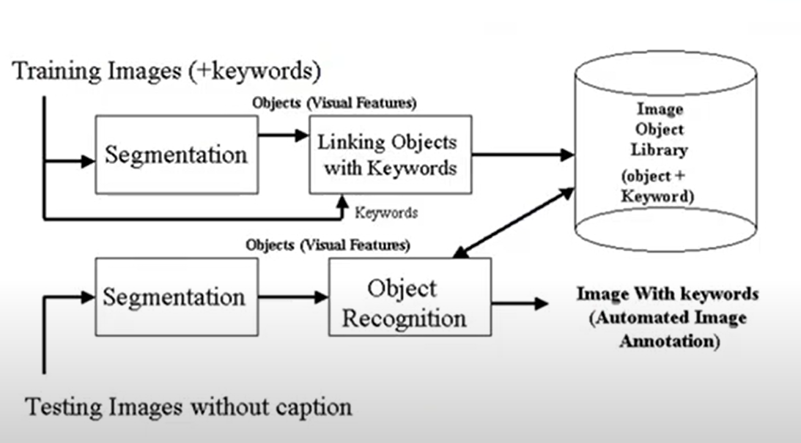
Annotation

Slide 16
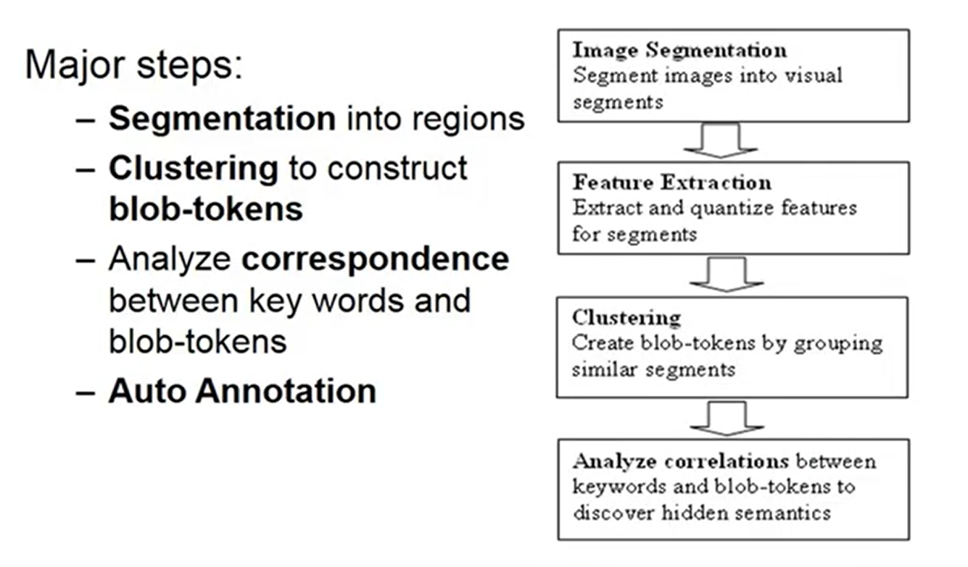
Annotation

Slide 17
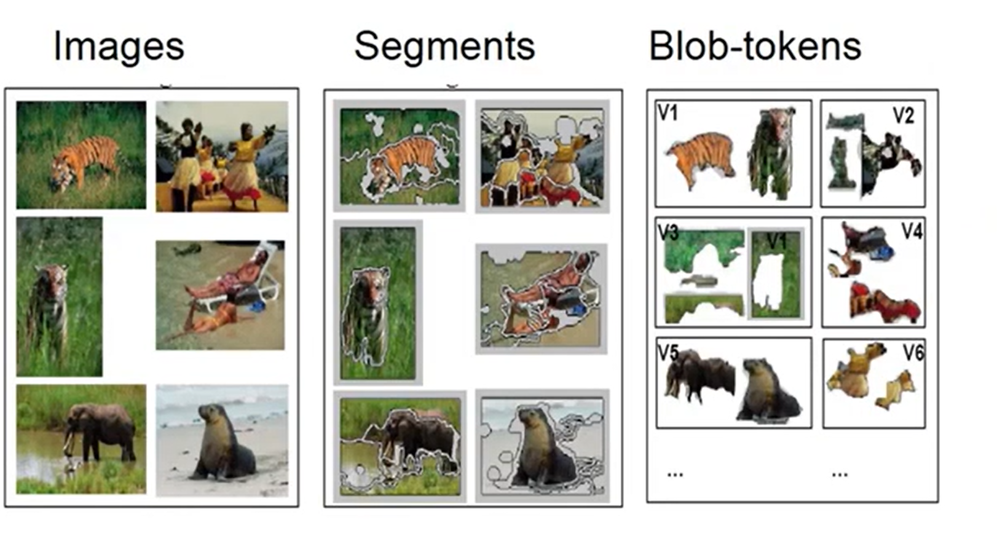
Annotation segmentation and Clustering

Slide 18
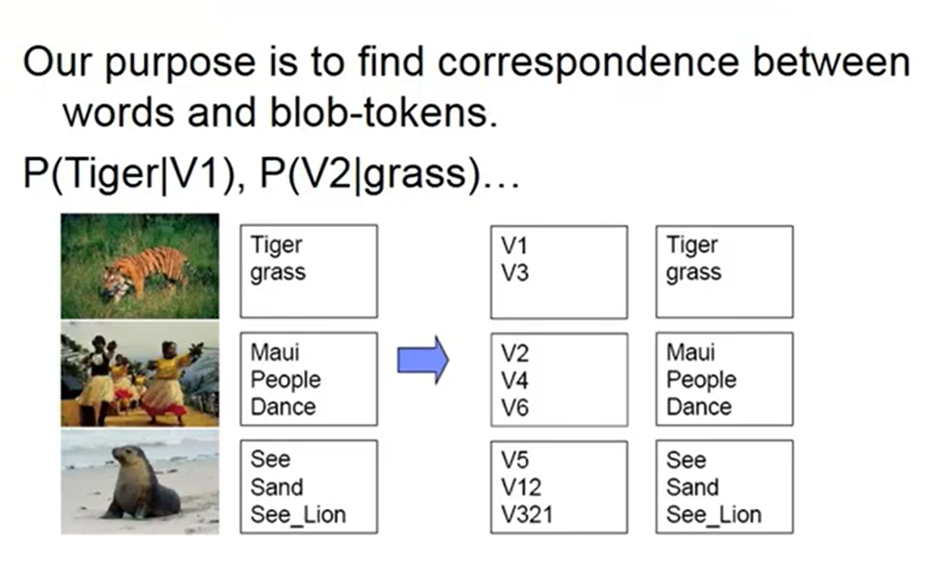
Annotation linking

Slide 19
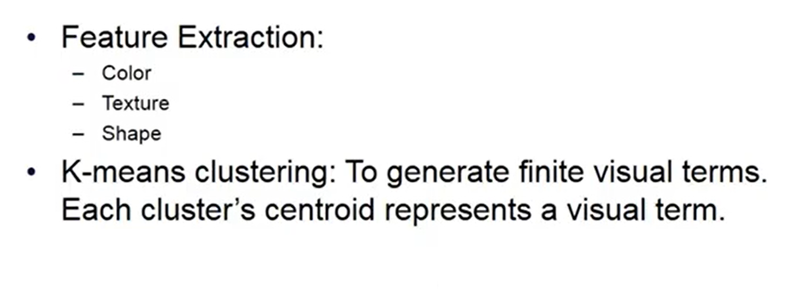
Feature Extraction and Clustering

Slide 20
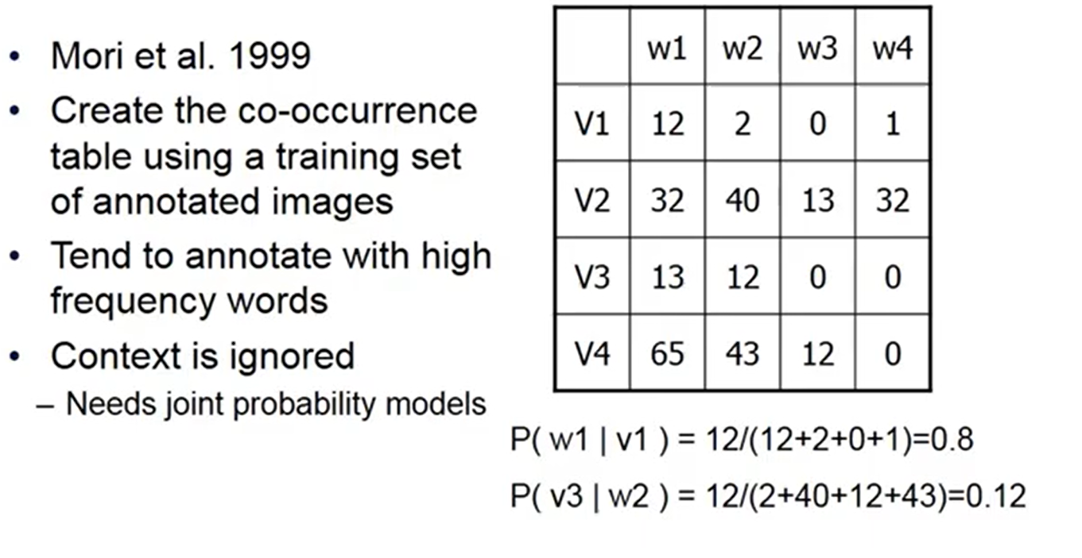
Co-Occurrence Model

Slide 21
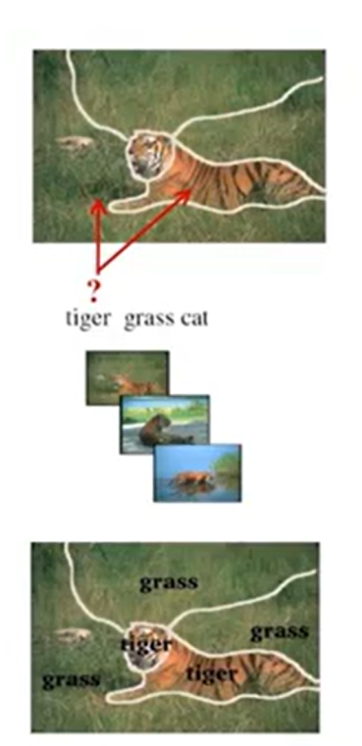
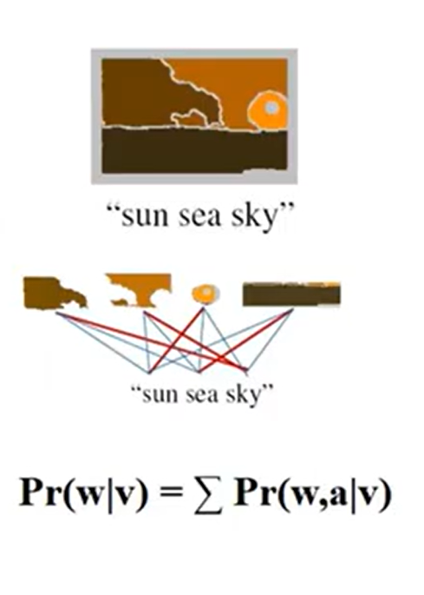
Correspondence : Translation Model(TM)

Slide 22
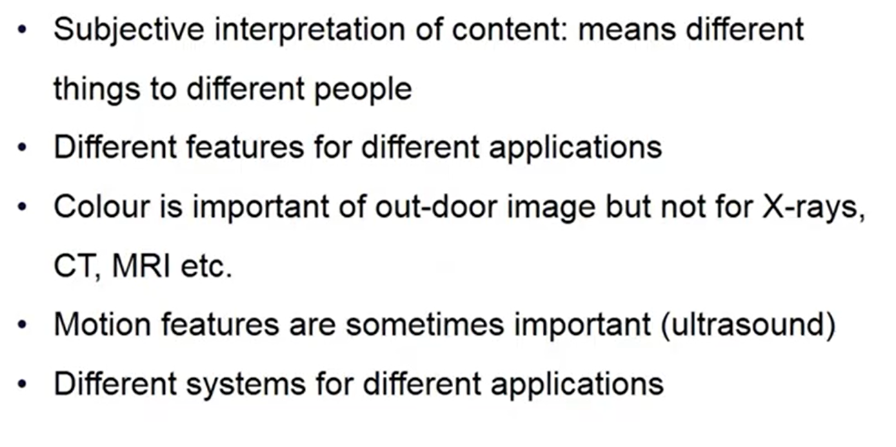
Image Description

Slide 23
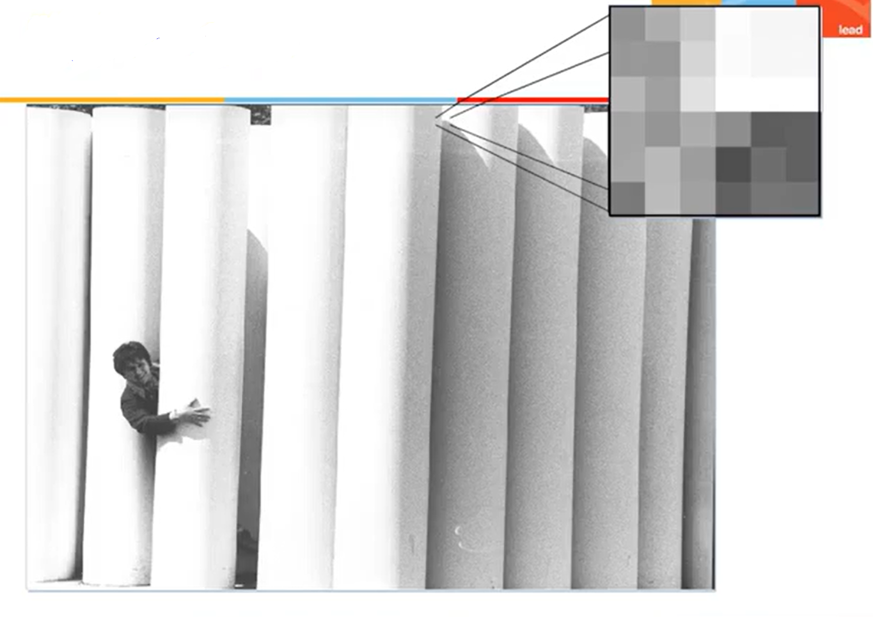
Digital Image

Slide 24
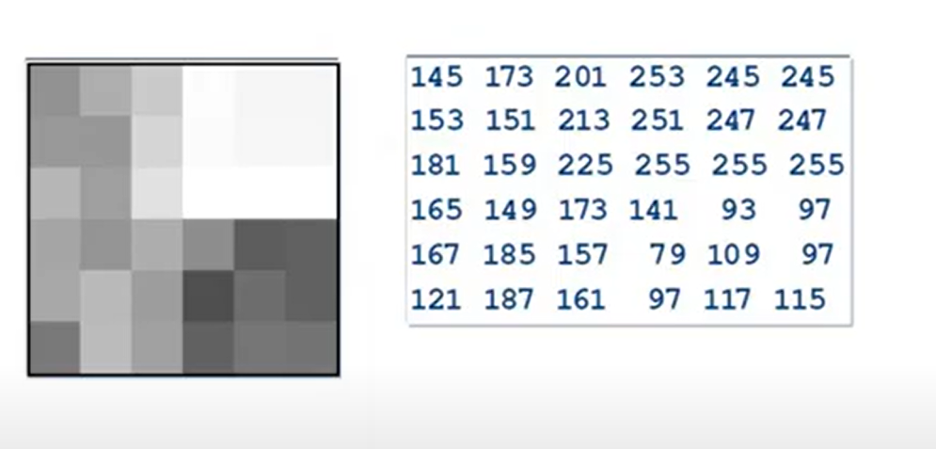

Slide 25
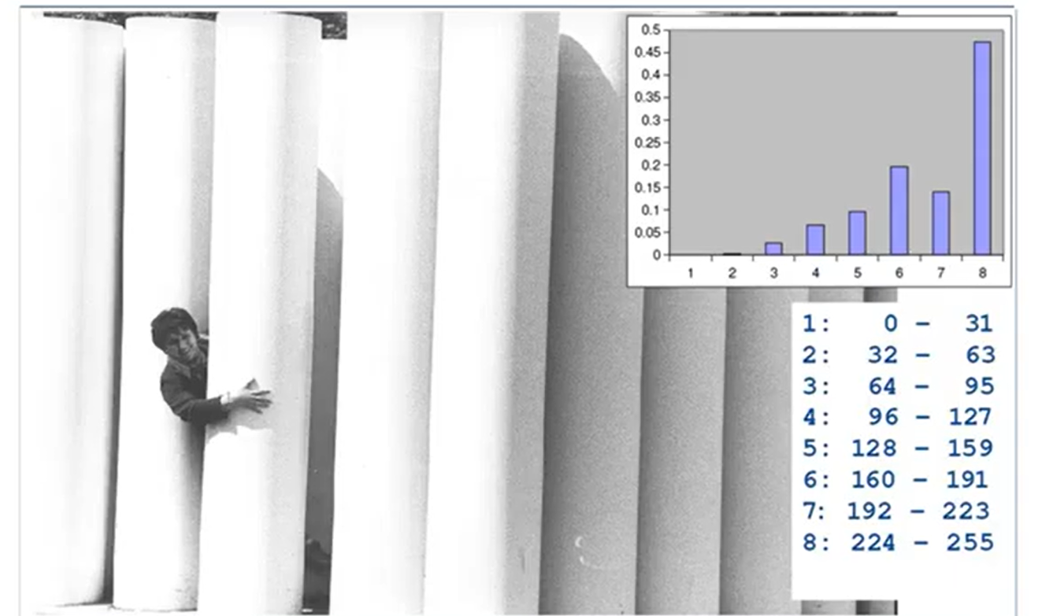
Histogram

Slide 26
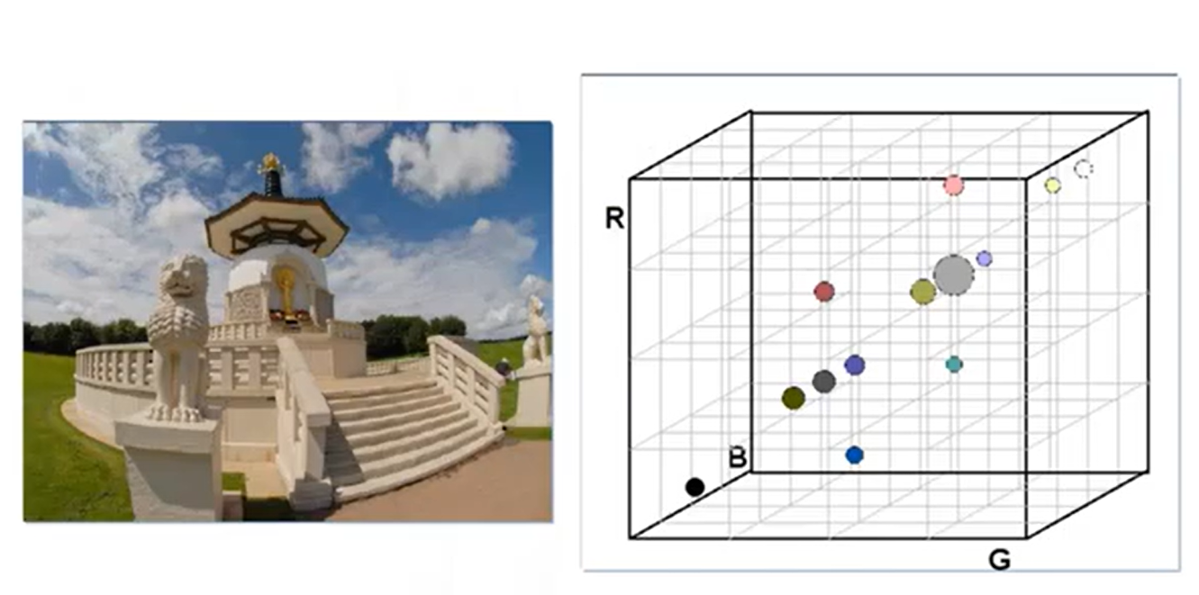
Color Histogram

Slide 27
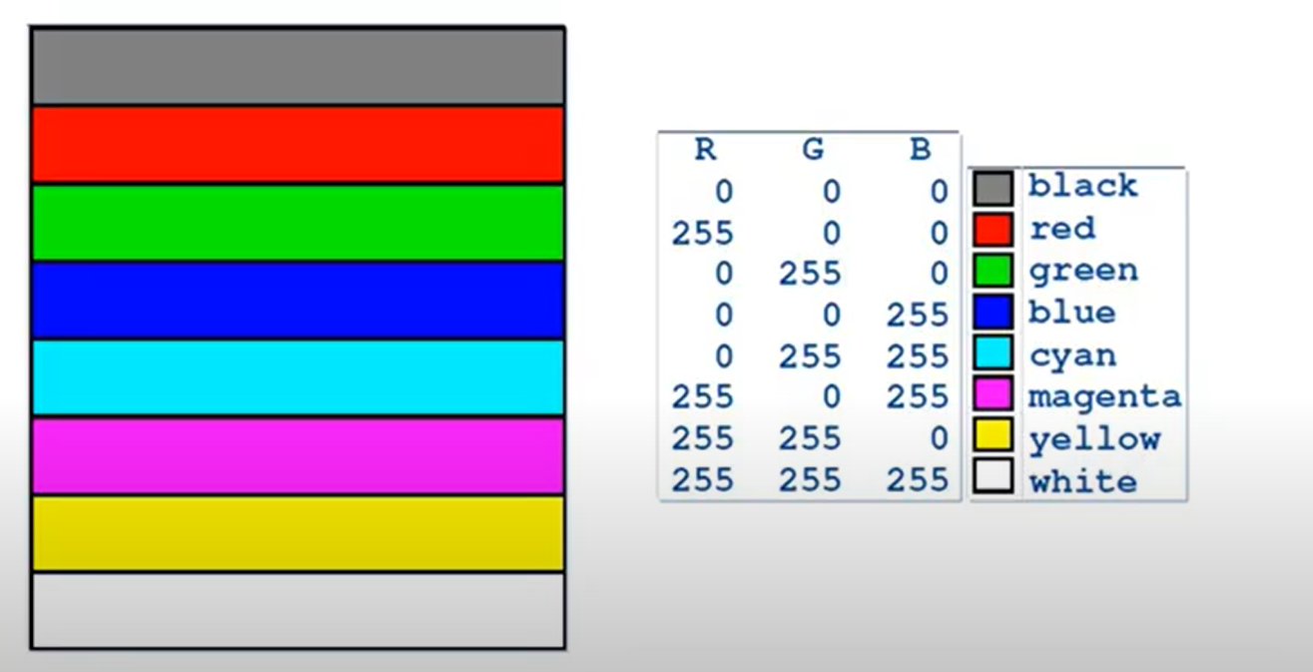
Color code

Slide 28
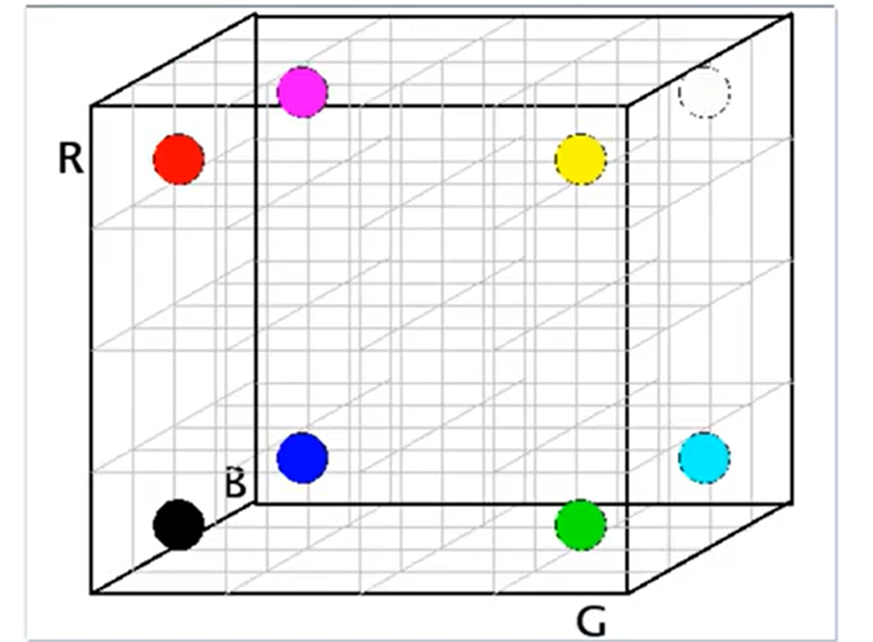

Slide 29
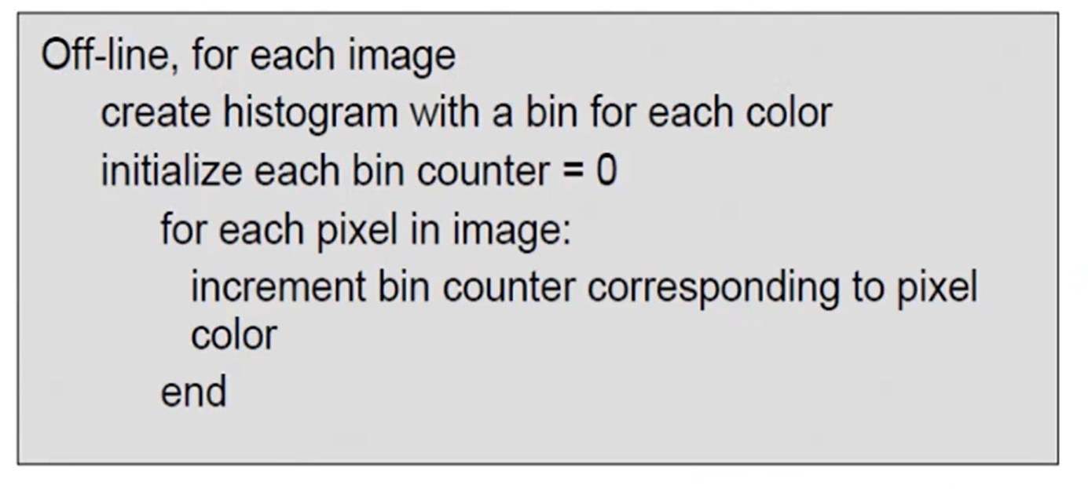

Slide 30
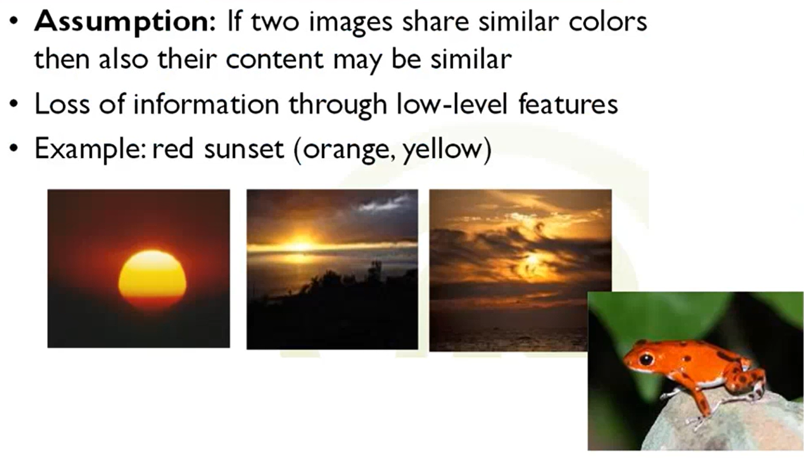

Slide 31
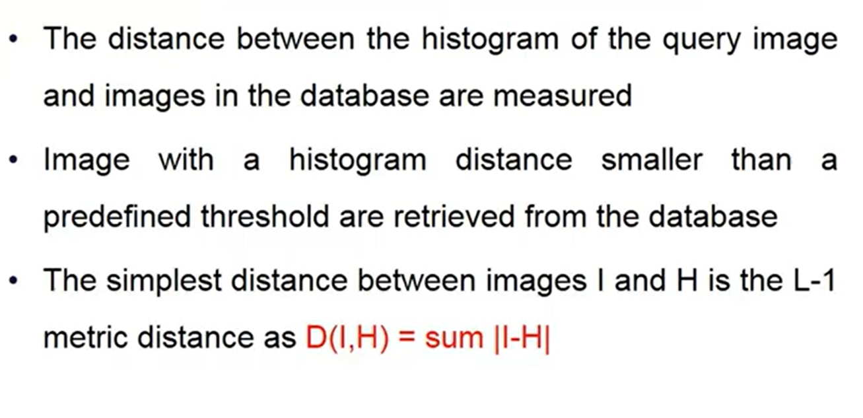
Simple Histogram Distance Measure

Slide 32
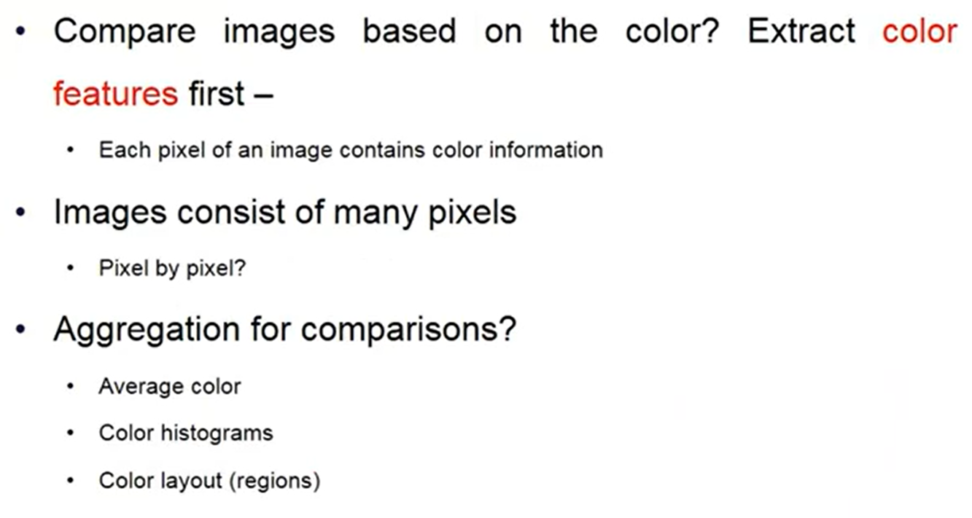
Comparison of Image

Slide 33
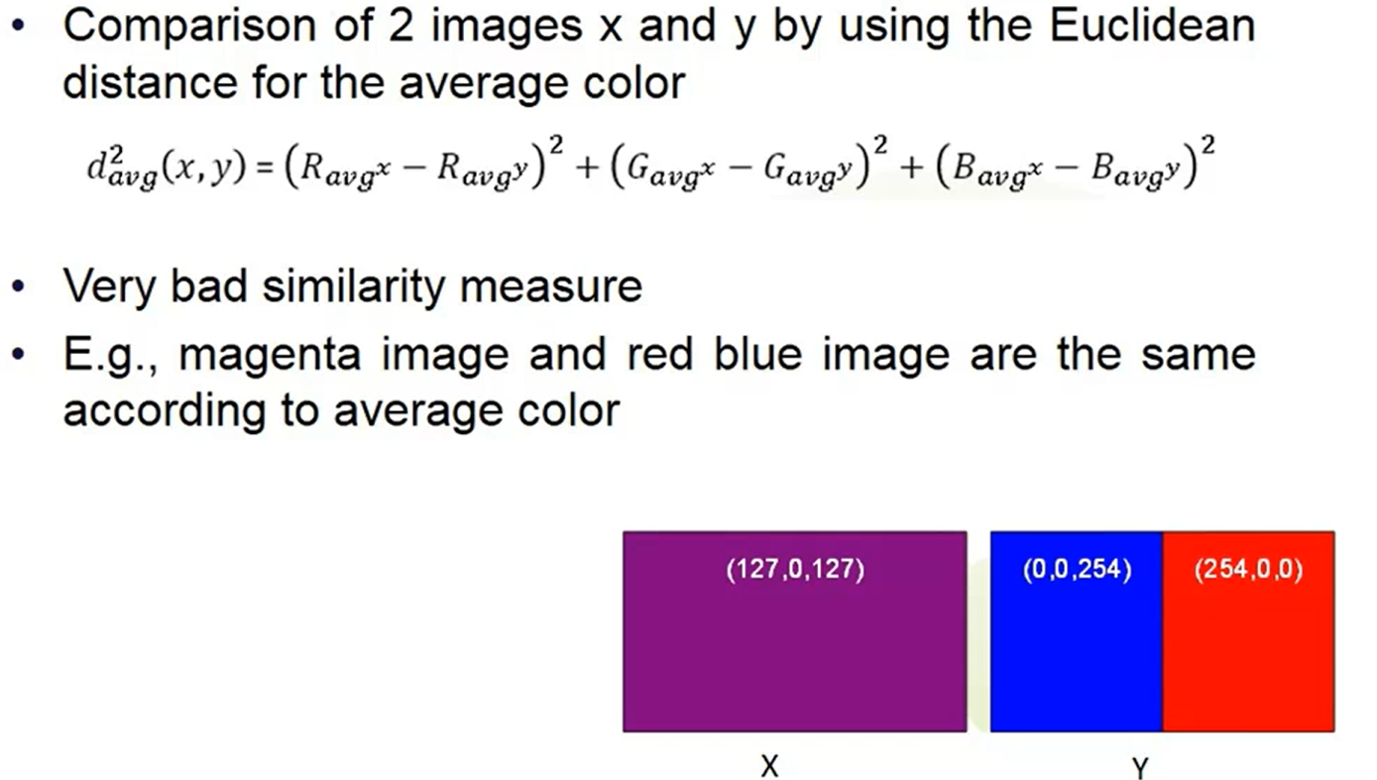
Average Color method

Slide 34
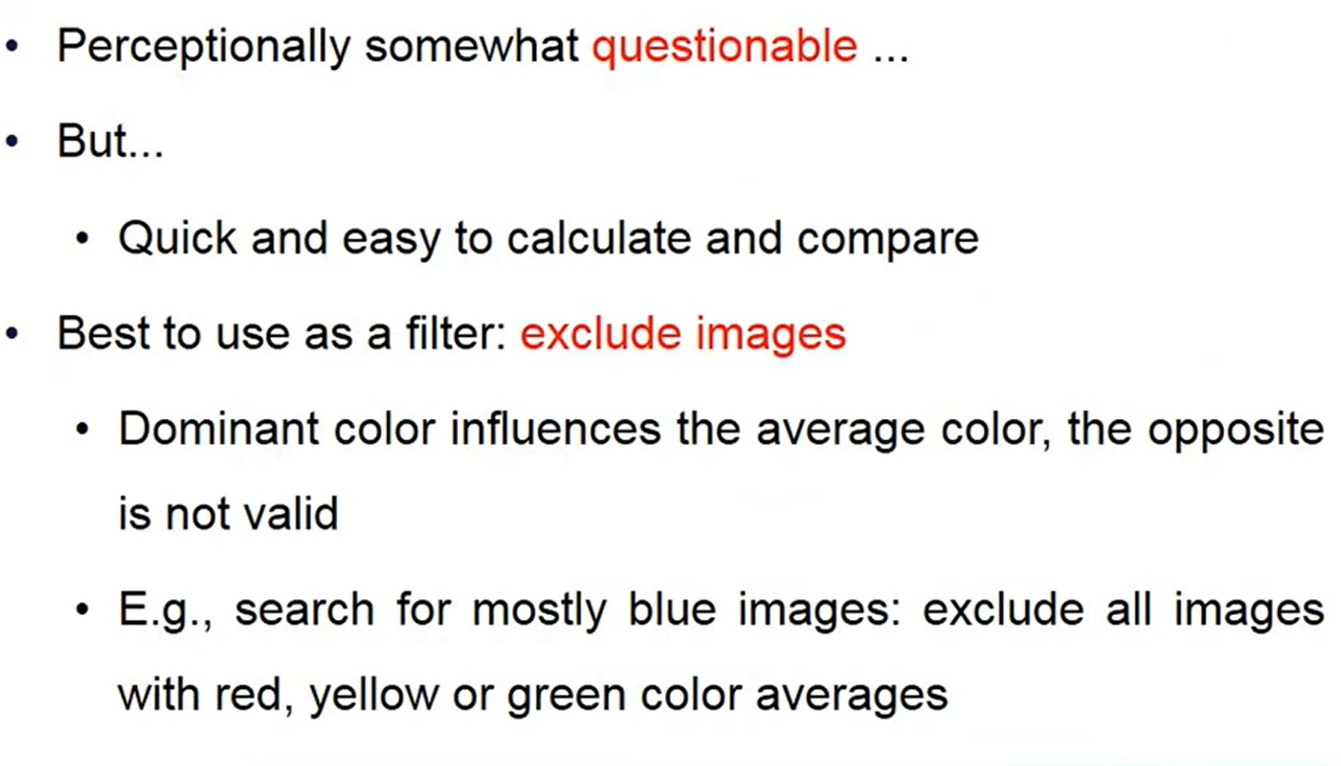
Problem with Average color method

Slide 35
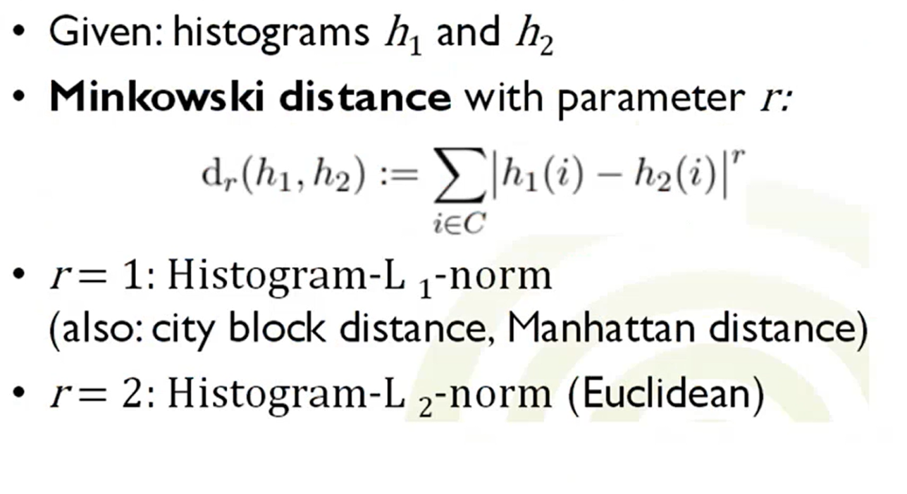
Histogram comparison method

Slide 36
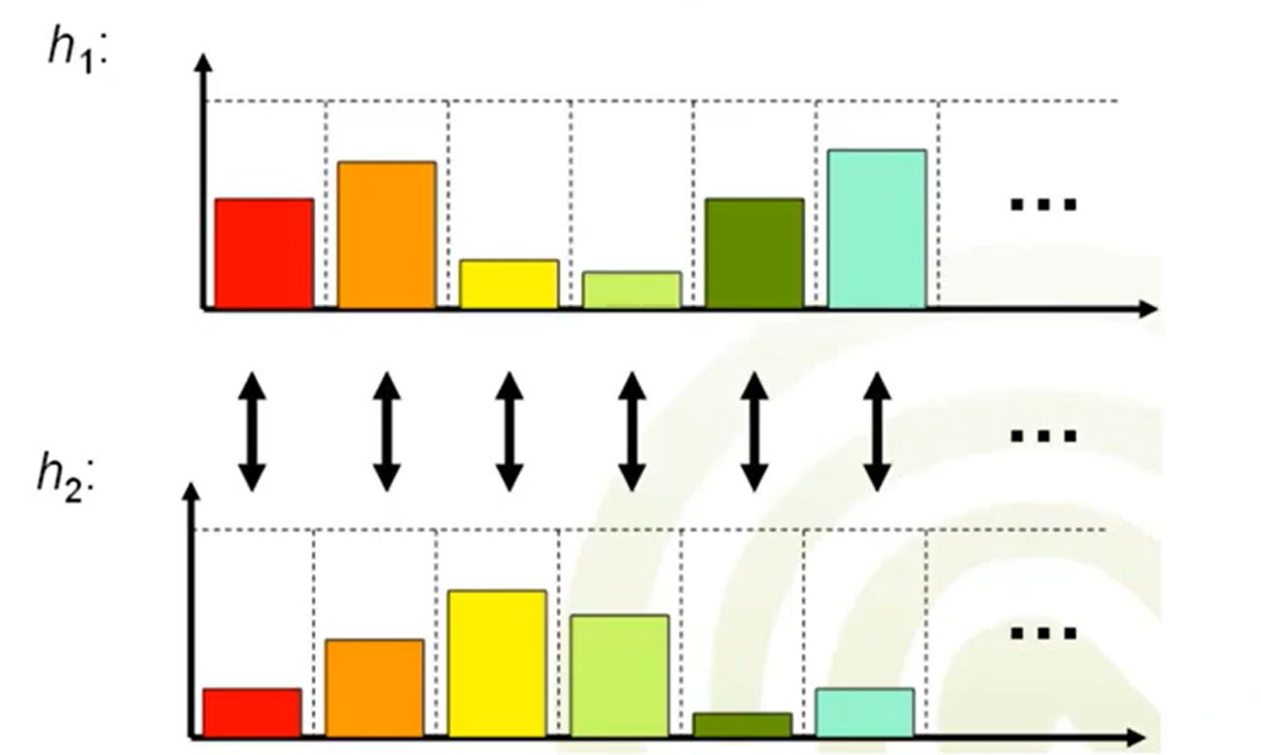
Minkowski Distance

Slide 37
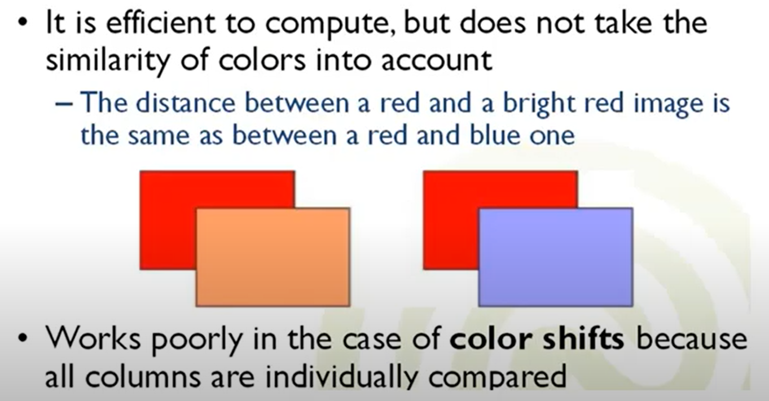
Problem with Minkowski Distance

Slide 38
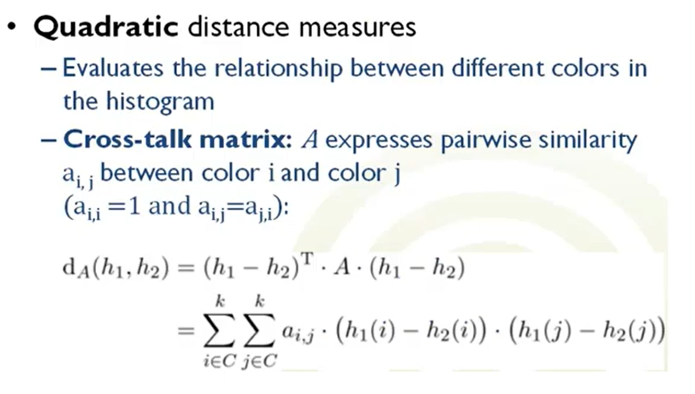
Quadratic distance measure(r=2)

Slide 39
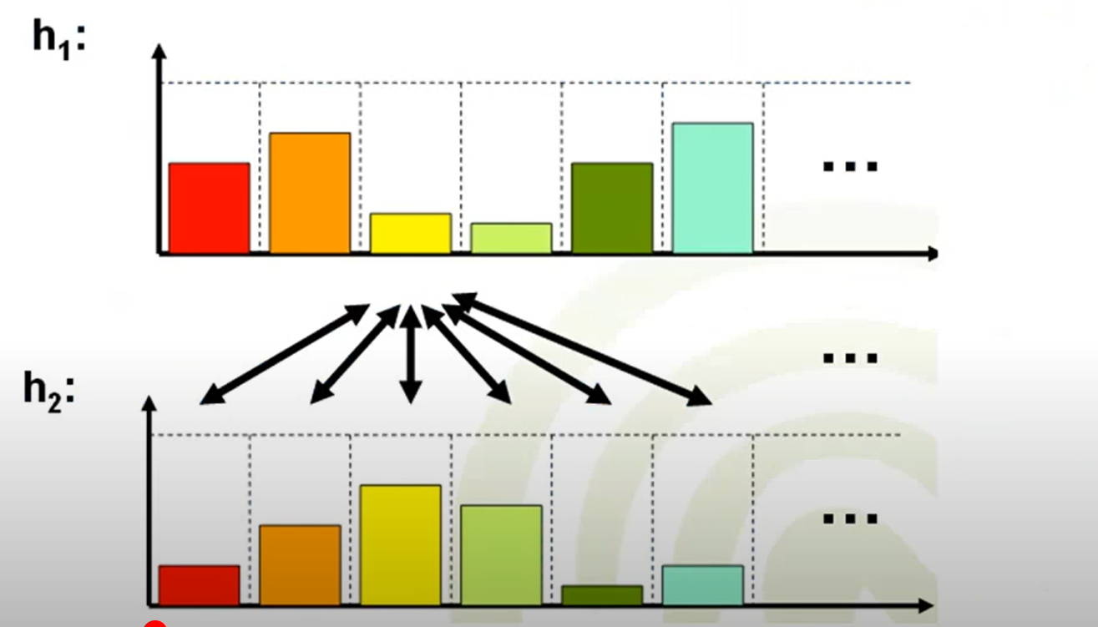
Quadratic distance measure

Slide 40
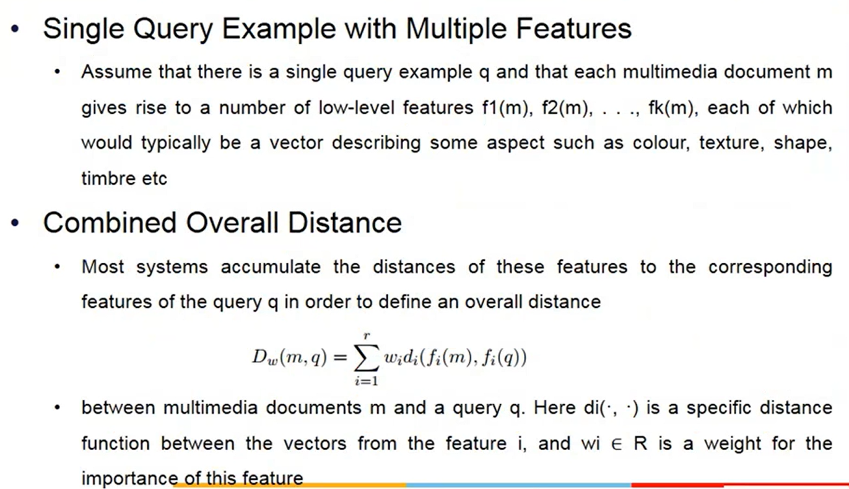
Fusion of features spaces and query results

Slide 41
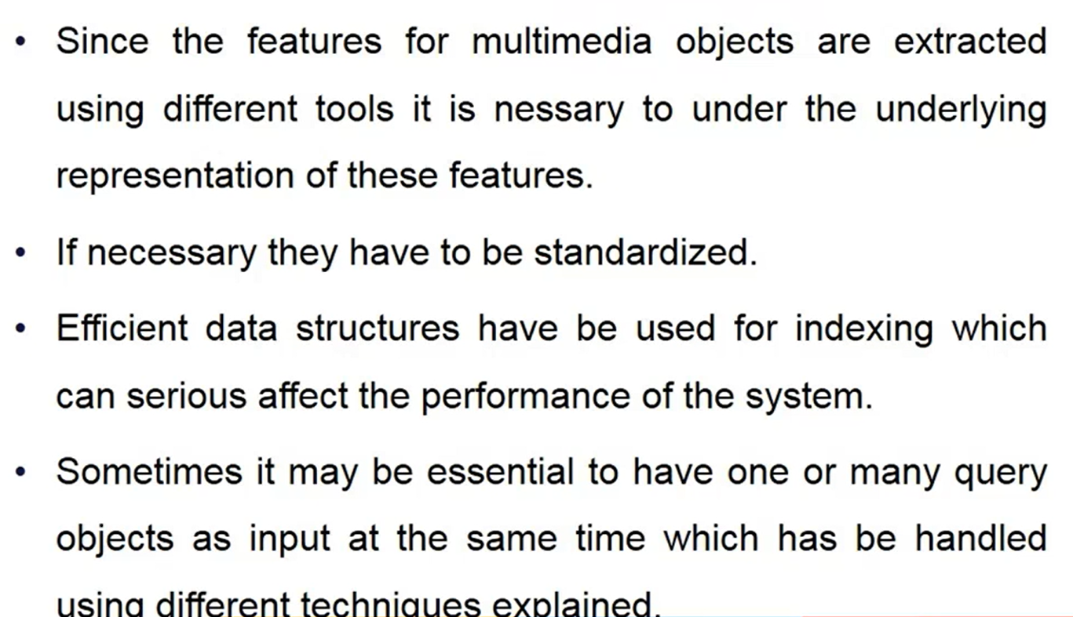
Take home message

